Slide 1
Irish History Project
By Georgia Bullard

Slide 2
James Stephens
James Stephens was an Irish Republican, and the founding member of an originally unnamed revolutionary organisation in Dublin. This organisation, founded on 17 March 1858, was later to become known as the Irish Republican Brotherhood.
Born: January 26, 1825, Kilkenny
Died: March 29, 1901, Blackrock

Slide 3
John O’Mahoney
John Francis O’Mahoney was a Gaelic scholar and the founding member of the Fenian Brotherhood in the United States, sister organisation to the Irish Republican Brotherhood.
Born: 1816
Died: February 7, 1877, New York

Slide 4
The IRB (Irish Republican Brotherhood)
The IRB was a secret oath-bound fraternal organization dedicated to the establishment of an independent democratic republic in Ireland between 1858 and 1924.
Its counterpart in the United States of America was initially the Fenian Brotherhood, but from the 1870s it was Clan Na Gael. The members of both wings of the movement are often referred to as Fenians.
The IRB played an important role in the history of Ireland, as the chief advocate of republicanism during the campaign for Irelands independence from the United Kingdom, successor to movements such as the United Irishmen of the 1790s and the young Irelanders of the 1840s.

Slide 5
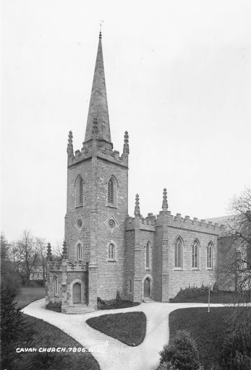
The Catholic church and the Fenians
The struggle between the Catholic church and the Fenians, as this evolved in the mid-nineteenth century, had its origins in the wider context of the church’s horror of revolution and revolutionary movements.
The locus classicus for this antipathy was the experience of the French revolution and its aftermath. Equally, the spectre of revolution haunted Europe from the 1830s and would culminate, so far as the church was concerned, in the sweeping away of the centuries-old Papal States in 1860 and the loss of Rome to the Italians in 1870.
Thereafter plus IX declared himself to be the prisoner of the Vatican and forbade Catholics to have anything to do with the new Italian political entity.

Slide 6
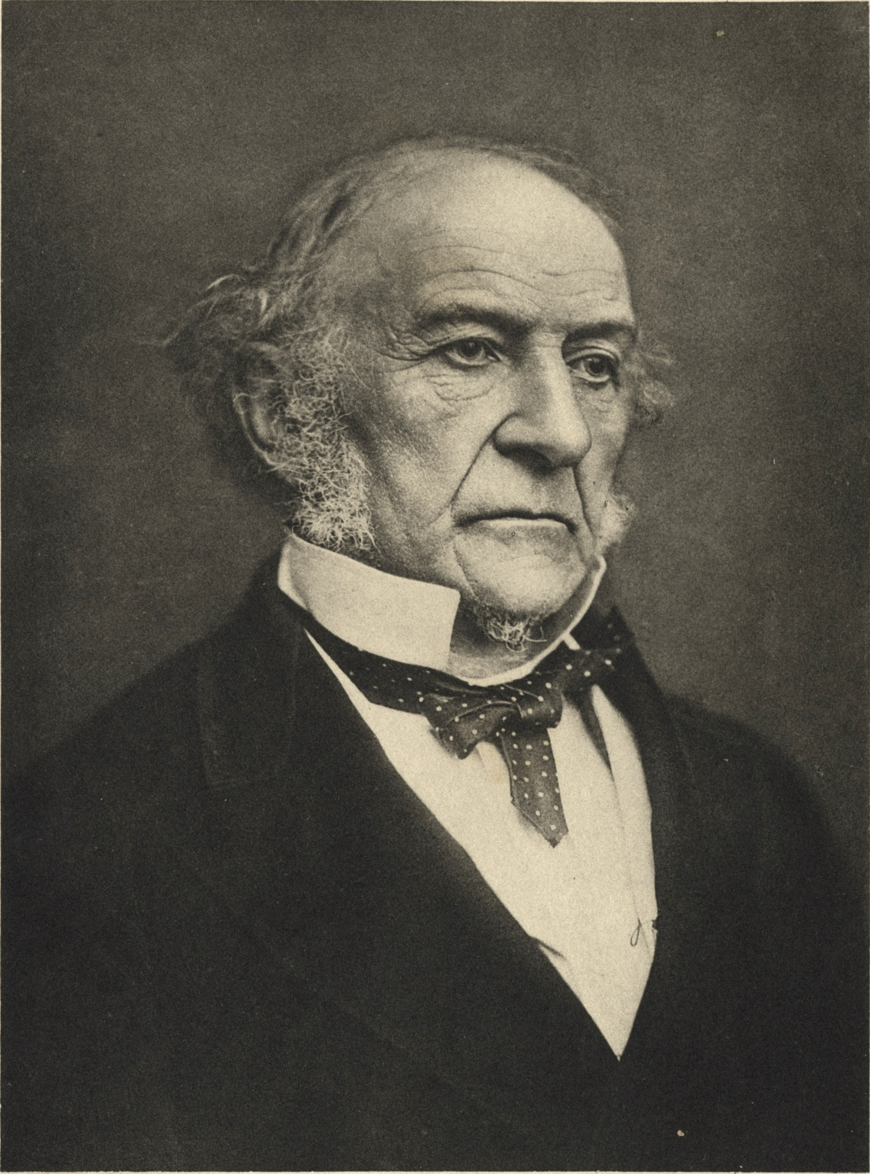
William Ewart Gladstone
William Ewart Gladstone was a British statesman and Liberal politician. In a career lasting over 60 years, he served for 12 years as Prime Minister of the United Kingdom, spread over four terms beginning in 1868 and ending in 1894
Born: December 29,1809, Rodney Street, Liverpool, United Kingdom
Died: May 19, 1898, Hawarden Castle, United Kingdom
Party: Liberal Party.

Slide 7
Plotting Rebellion
As part of the New Departure of the 1870s-80s, IRB members attempted to infiltrated the Home Rule League. And its successor, the Irish Parliamentary Party, as well as taking part in the Land War.
The IRB staged the Easter Rising in 1916, which led to the establishment of the first Dáil Eireann in 1919. The suppression of Dáil Eireann precipitated the Irish War of Independence and the signing of the Anglo-Irish Treaty in 1921, ultimately leading to the establishment of the Irish Free State, which excluded the territory of Northern Ireland.

Slide 8
Fenians In England
The Fenians in England and the Empire were a major threat to political stability.
On 23 November 1867, three Fenians, William Philip Allen, Michael O’Brian, and Michael Larkin, known as the Manchester Martyrs, were executed in Salford for their attack on a police van to release Fenians held captive earlier that year.

Slide 9
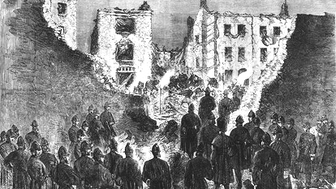
Rescue Attempt In England
After the suppression of the Irish People newspaper in September 1865, disaffection among Irish radical nationalists continued to smoulder, and during the later part of 1866, IRB leader James Stephens endeavoured to raise funds in the United States for a fresh rising planned for the following year. However the rising took place in County Kerry in February, followed by an attempt at nationwide insurrection, including an attempt to take Dublin in early March.
Due to poor planning and British infiltration of the nationalists, the rebellion never got off the ground. Most of the leaders in Ireland were arrested, but although some of them were sentenced to death, none suffered execution. There followed a series of attacks in England aimed at freeing Fenian prisoners, including a bomb in London and an attack on prison van in Manchester, for which three Fenians, subsequently known as the Manchester martyrs, were executed in November 1867.

Slide 10
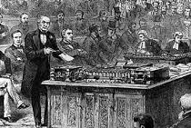
The Home Rule Party
The Irish Parliamentary Party commonly called the Irish Party, or the Home Rule Party was formed in 1874 by Isaac Butt. the leader of the Nationalist Party, replacing the Home Rule League, as official parliamentary party for Irish nationalist Members of Parliament elected to the House of Commons at Westminster within the United Kingdom of Great Britain and Ireland up until 1918.

Slide 11
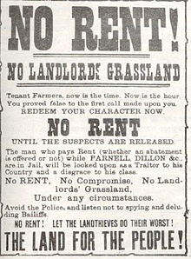
The Land War
The Land War was a period of agrarian agitation in rural Ireland that began in 1879. It may refer specifically to the first and most intense period of agitation between 1879 and 1882, or include later outbreaks of agitation that periodically reignited until 1923, especially the 1886-1891 Plan of Campaign and the 1906-1909 Ranch War.
The agitation was led by the Irish National League and the United Irish League, and aimed to secure fair rent, free sale, and fixity of tenure for tenant farmers and ultimately peasant proprietorship of the land they worked.

Slide 12
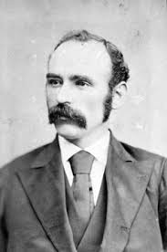
Michael Davitt
Michael Davitt was an Irish republican activist for a variety of causes, especially Home Rule and land reform. Following an eviction when he was four years old, Davitt’s family emigrated to England.
Born: March25, 1846, Strade
Died: May 30, 1906, Dublin
Known for: Irish Land League activism
Children: Cahir Davitt and Robert Davitt
Organization founded: Irish National Land League

Slide 13
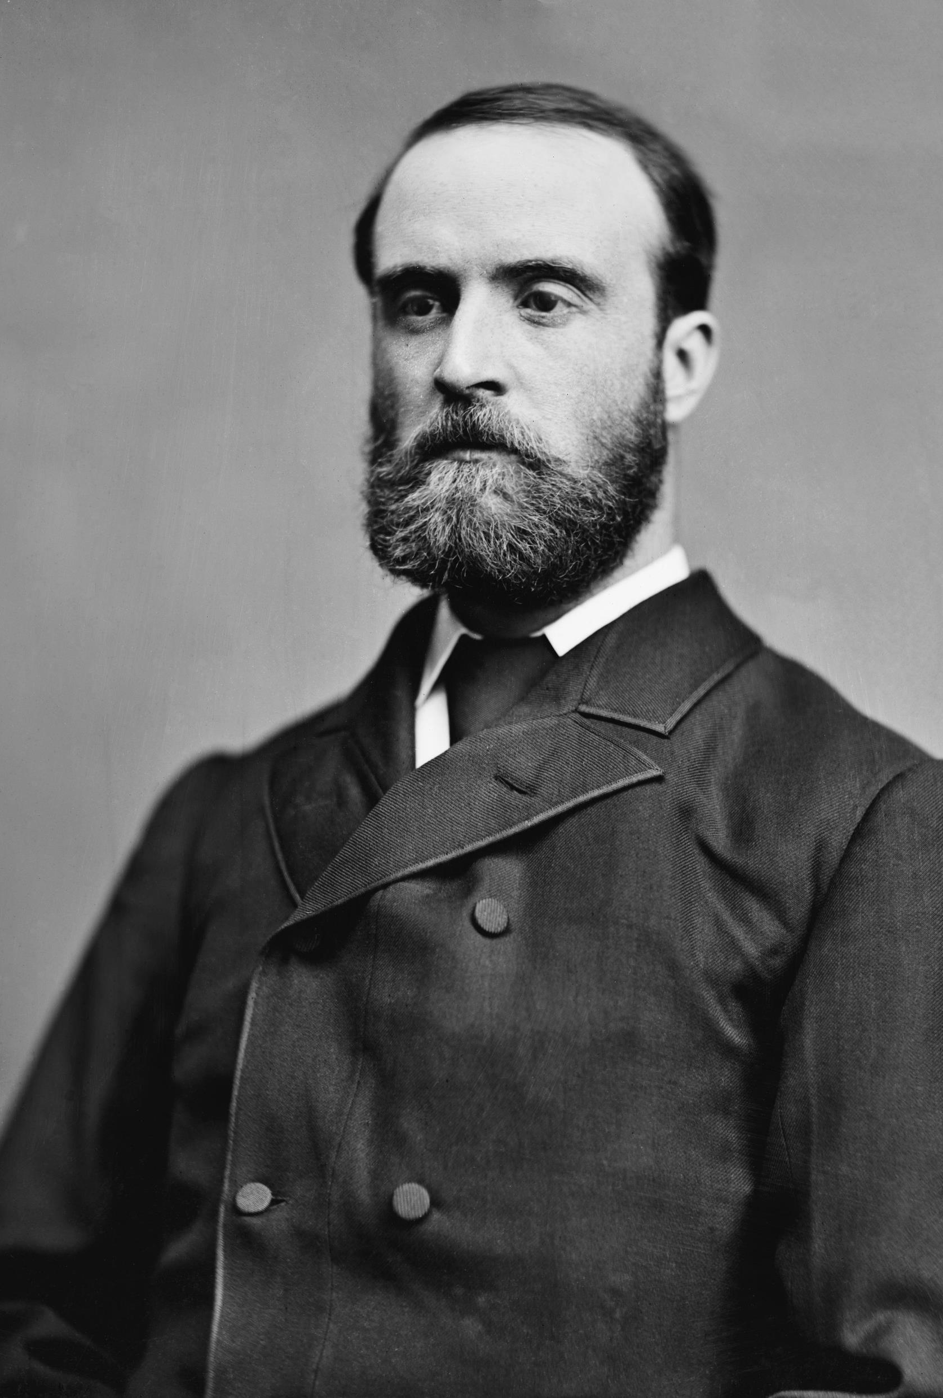
Charles Stewart Parnell
Charles Stewart Parnell was an Irish Nationalist politician who served as Leader of the Irish Parliamentary Party from 1880 to 1882. He served as a member of parliament from 1875 to 1891.
Born: June 27, 1846, Avondale House
Died: October 6, 1891, Hove, United Kingdom
Place of burial: Glasnevin Cemetery, Dublin

Slide 14
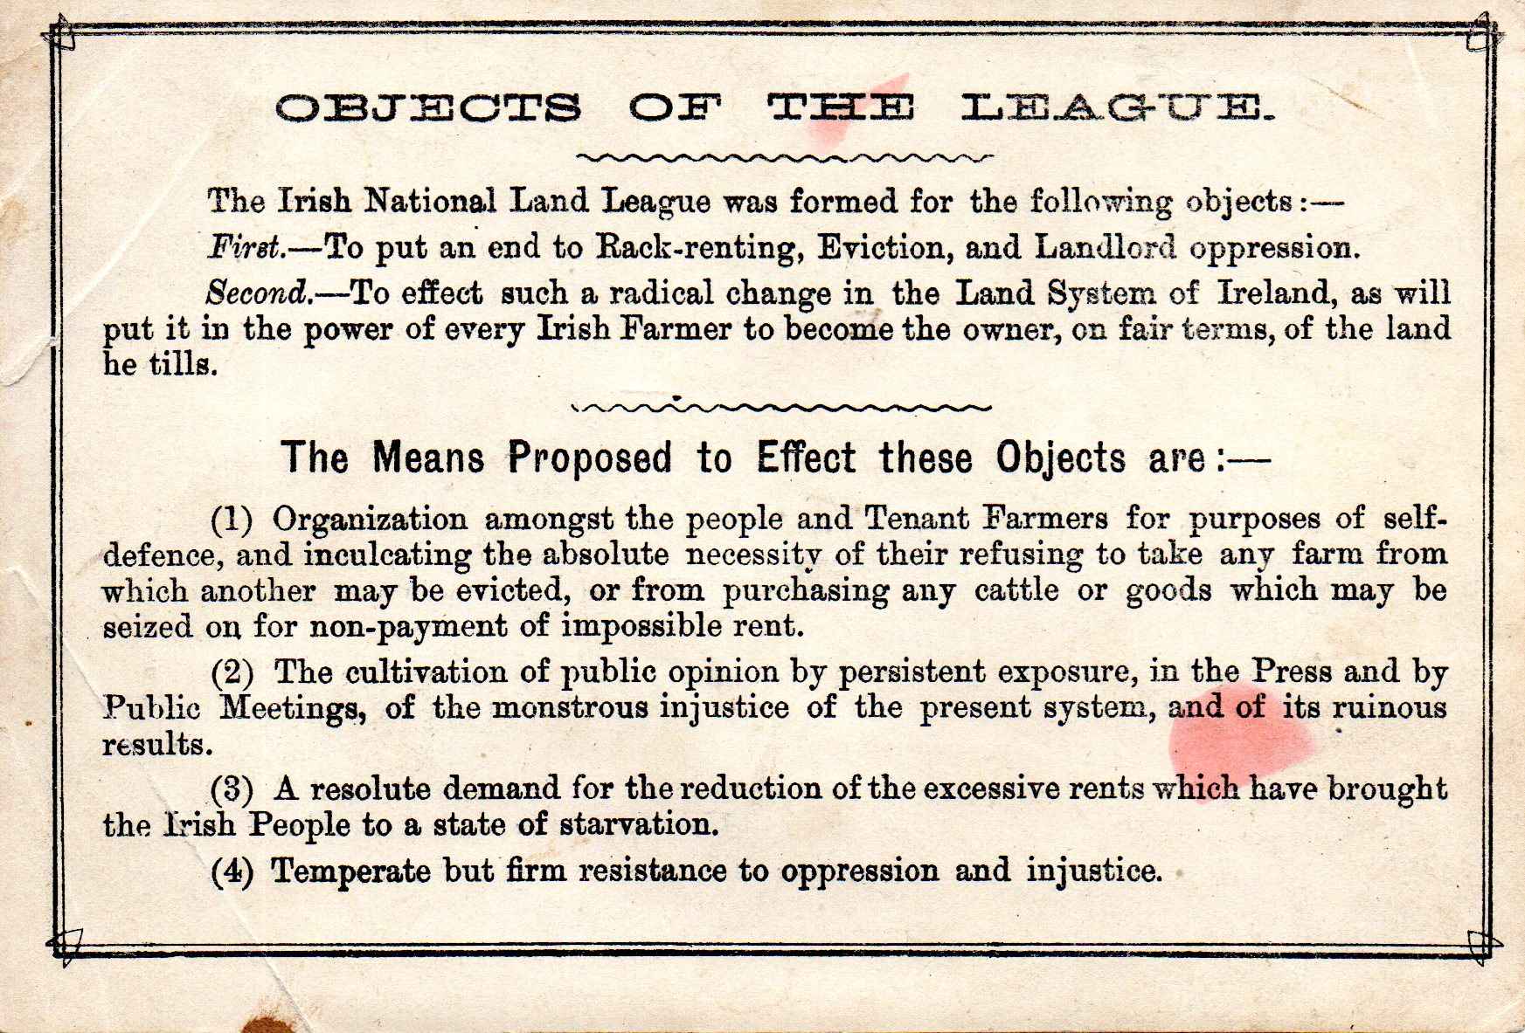
The Land League
The Irish National Land League was an Irish political organization of the late 19th century which sought to help poor tenant farmers. Its primary aim was to abolish landlordism in Ireland and enable tenant farmers to own the land they worked on.
Date founded: 21 October 1879
Place founded: Castlebar

Slide 15
The British General Election Of 1880
The 1880 United Kingdom general election was a general election in the United Kingdom held from 31 March to 27th of April 1880.
Its intense rhetoric was led by the Midlothian campaign of the Liberals, particularly the fierce oratory of Liberal leader William Ewart Gladstone.

Slide 16
Ladies’ Land League
The Ladies’ Land League was founded on the 31st of January 1881 and was dissolved on the 10th of August 1882.
The Ladies Land League was an auxiliary of the Irish National Land League and took over the functions of that organization when its leadership was imprisoned.

Slide 17
End Of Land War
Land Acts. The land question in Ireland was ultimately defused by a series of Irish Land Acts, beginning in 1870 with rent reform, establishing the Land Commission in 1881, and providing for judicial reviews to certify fair rents.

Slide 18
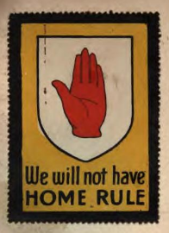
The Home Rule Party Is Defeated!
The First Home Rule Bill was presented to the House of Commons by the Liberal and Irish Parliamentary Party coalition. This bill failed to pass through the House of Commons, with Gladstone’s own MPs voting against it, causing the government to collapse, leading to a General Election in 1886, and the collapse of power for the Home Rule Party. This resulted in serious riots in Belfast during the Summer and Autumn of 1886 in which many were killed, and caused the Liberal Unionist Association to split from the main Liberal party.

Slide 19
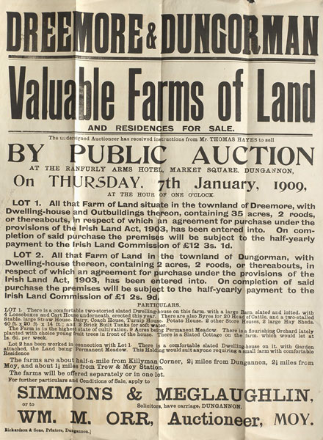
The Land Act Of 1903
Under the 1903 Land Act, tenants received from the government an advance to purchase the land, which was to be repaid through annuities (yearly installments) over a period of 68.5 years… within these ranges it was left to landlords and tenants to agree upon a price.

Slide 20
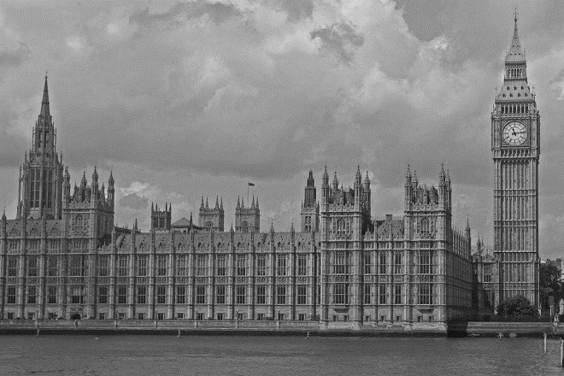
The Third Home Rule Bill
The Government of Ireland Act of 1914, also known as the Home Rule Act, and before enactment as the Third Home Rule Bill, was an Act passed by the Parliament of the United Kingdom intended to provide home rule for Ireland.

Slide 21
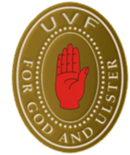
The Ulster Response
As a response to these attacks, the UVF was revived. However, this revival was largely unsuccessful and the UVF was absorbed into the Ulster Special Constabulary, the reserve police force of the Northern Ireland Government.

Slide 22
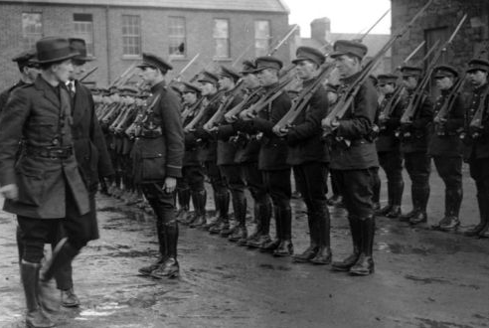
Irish Civil War
The Irish civil war was a conflict that followed the Irish War of independence and accompanied the establishment of the Irish Free State, an entity independent from the United Kingdom but within the British Empire.

Slide 23
Why did world war one have an impact on possible civil war?
#
Ireland throughout the First world war of 1914-1918 was an integral part of the United Kingdom of Great Britain and Ireland. But its experience of the Great War was quite different from that of England, Scotland or Wales.
In Ireland, engagement with the war was less and casualties were lighter, but the war was also much more divisive and ultimately helped to speed Ireland’s secession from the United Kingdom.

Slide 24
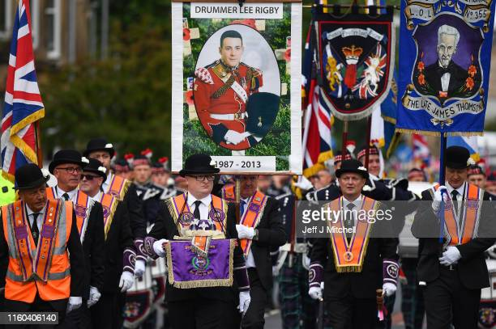
The Orange Order
The Loyal Orange institution, commonly known as the Orange order, is an international Protestant fraternal order based in Northern Ireland.
It also has lodges in England, Scotland and the Republic of Ireland, as well as throughout the British Commonwealth and the United States.

Slide 25
G.A.A
The Gaelic Athletic Association is an Irish international amateur sporting and cultural organization, focused primarily on promoting indigenous Gaelic games and pastimes, which include the traditional Irish sport of hurling, camogie, Gaelic football, Gaelic handball and rounders.
Founder: Michael Cusack
Founded: November 1, 1884
Headquarters: Dublin

Slide 26
The Gaelic League
Conradh na Gaeilge is a social and cultural organisation which promotes the Irish language in Ireland and worldwide.
The organisation was founded in 1893 with Douglas Hyde as its first president, when it emerged as the successor of several 19th century groups such as the Gaelic Union.

Slide 27
Sinn Fein
Sinn Fein is an Irish republican and democratic socialist political party active in both the Republic of Ireland and Northern Ireland.
Founder: Arthur Griffith
Founded: November 28th, 1905
Current Leadership: Mary Lou McDonald

Slide 28
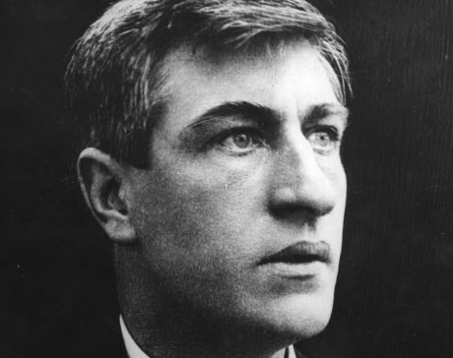
James Larkin
James Larkin, sometimes known as Jim Larkin, was an Irish republican, socialist and trade union leader. He was one of the founders of the Irish Labour Party, the Irish Transport and General Workers union, the Workers’ Union of Ireland Citizen Army. Larkin was born to Irish parents in Liverpool, England.

Slide 29
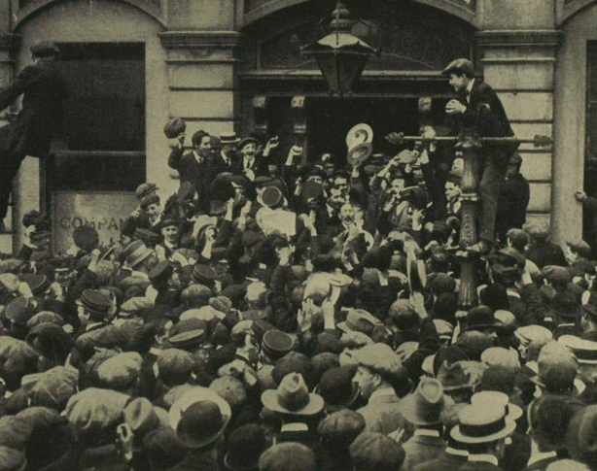
The 1913 Lock-out
The Dublin lock-out was a major industrial dispute between approximately 20,000 workers and 300 employers which took place in Irelands capital city of Dublin.
The dispute lasted from 26th of August 1913 to the 18th of January 1914 and is often viewed as the most severe and significant industrial dispute in Irish history.

Slide 30
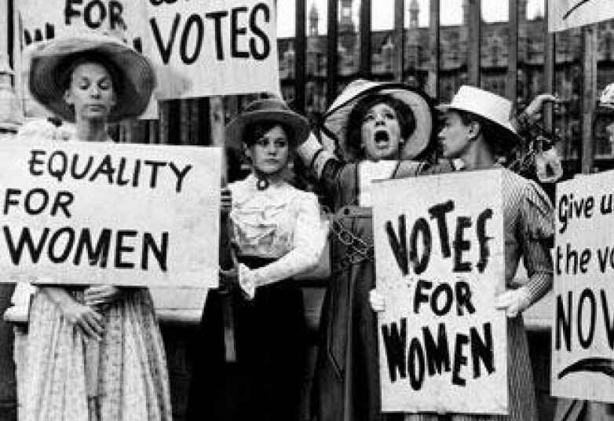
Votes For Women
Women suffrage is the right of women to vote in elections. Beginning in the mid-19th century, aside from the work being done by women for broad-based economic and political equality and for social reforms, women sought to change voting laws to allow them to vote
New Zealand and then Australia were the first ever country to allow women to vote.

